Slide 1

E-Commerce Guardrail: Fake Review Detection and Suspicious Return Behaviour Prediction
MINOR PROJECT
Submitted By:-
ANKIT AGRAWAL :- 25SCSE2240104
ABHISHEK RAJPOOT :- 25SCSE2240010
HARSH RAJ SINHA :- 25SCSE2240011
COURSE :- MCA
SECTION – 10 Submitted:-
Dr. JYOTI Ma’am

Slide 2
Problem Statement
Fake reviews can manipulate customer trust and distort product ratings.
Unusual return and refund patterns can expose e-commerce businesses to financial losses.
Analysing reviews and return behaviour separately may overlook valuable risk signals.
Businesses need a unified system that identifies suspicious patterns and explains why a case deserves attention.
Project Objectives
Build a machine-learning system to assess fake-review risk and suspicious return behaviour.
Combine both risk scores into a single Combined Risk Index (CRI).
Present risk insights through an interactive, easy-to-understand dashboard.
Help users make informed decisions through explainable results and human review.

Slide 3
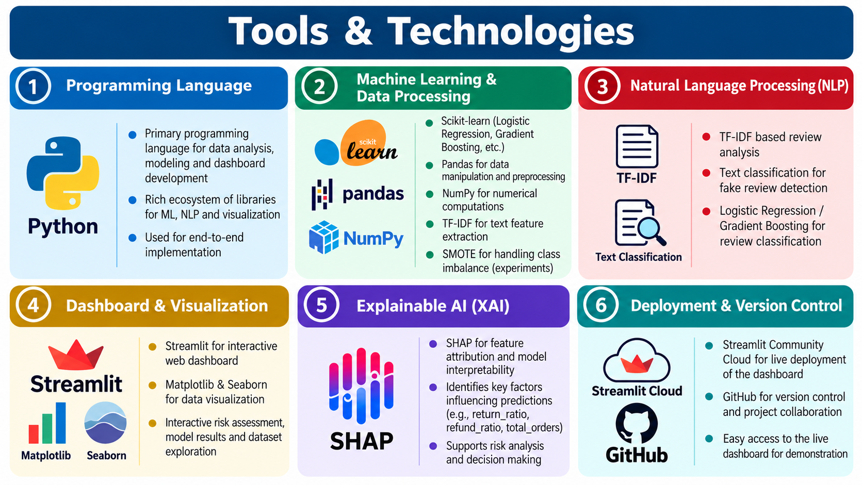
Tools and Technology

Slide 4
Proposed Methodology
1. Dataset Overview
Fake Review Dataset(Kaggle Dataset): 100,000 records with 58 columns, including 94.1% genuine-labelled and 5.9% fake-labelled reviews.
Online Retail II Dataset(UCI Dataset): Approximately 525,461 transaction records used to analyse customer purchasing and return behaviour.
2. Important Features
Review Module: Star rating, sentiment, emotion, and quality aspect.
Return Module: Total orders, total returns, total spending, total refunded amount, return ratio, and refund ratio.
Risk Fusion: Combined Risk Index (CRI) combines the two model scores.
3. Project Objectives & Methodology
Apply TF-IDF + Logistic Regression to estimate fake-review risk.
Use Gradient Boosting to identify suspicious return patterns.
Combine risk scores into Low, Medium/Uncertain, and High Risk categories.
Present understandable results through the GuardX AI Streamlit dashboard.

Slide 5
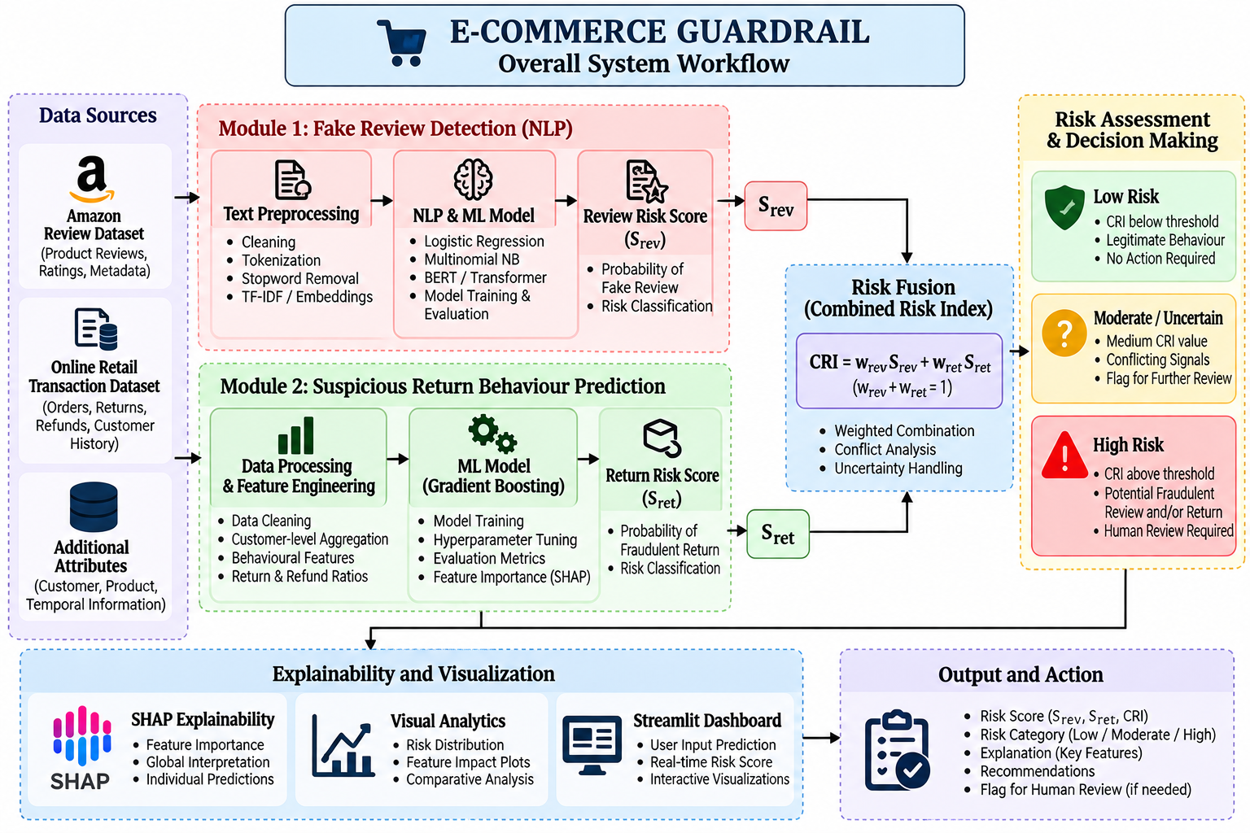
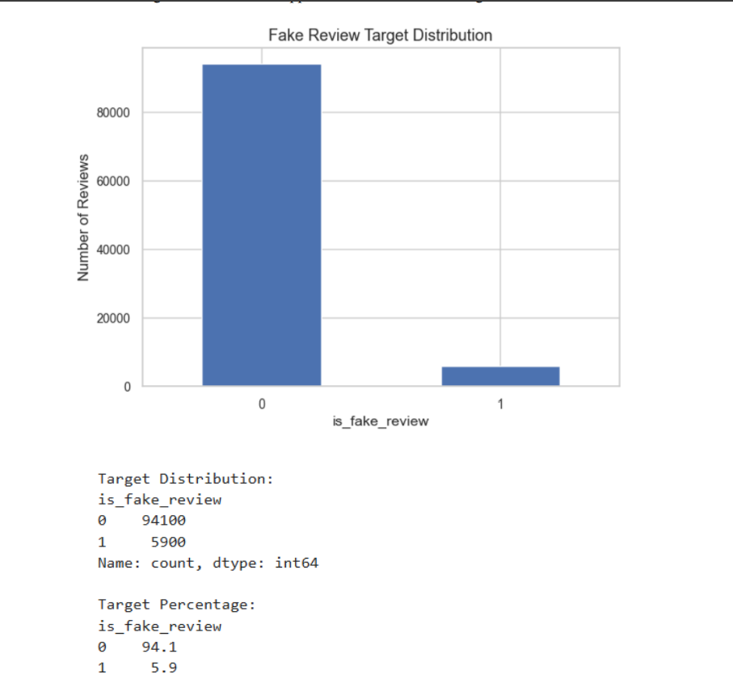
Workflow Architecture
Fake Review Distribution

Slide 6
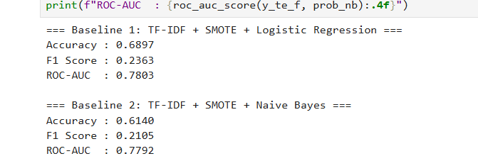
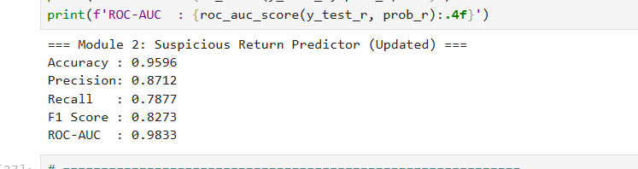
Machine Learning Models
TF-IDF: Converts review features into numerical text representations.
Logistic Regression: Performs fake-review classification using TF-IDF features.
Multinomial Naive Bayes: Provides a comparative model for fake-review detection.
SMOTE: Explores class-imbalance handling for fake-review classification.
DistilBERT: Explores transformer-based NLP for advanced review analysis.
Gradient Boosting Classifier: Predicts suspicious return behaviour using customer transaction features.
Model Evaluation: Uses accuracy, precision, recall, F1-score, and ROC-AUC.

Slide 7
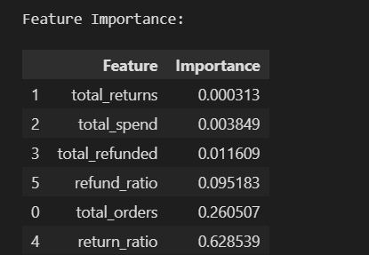
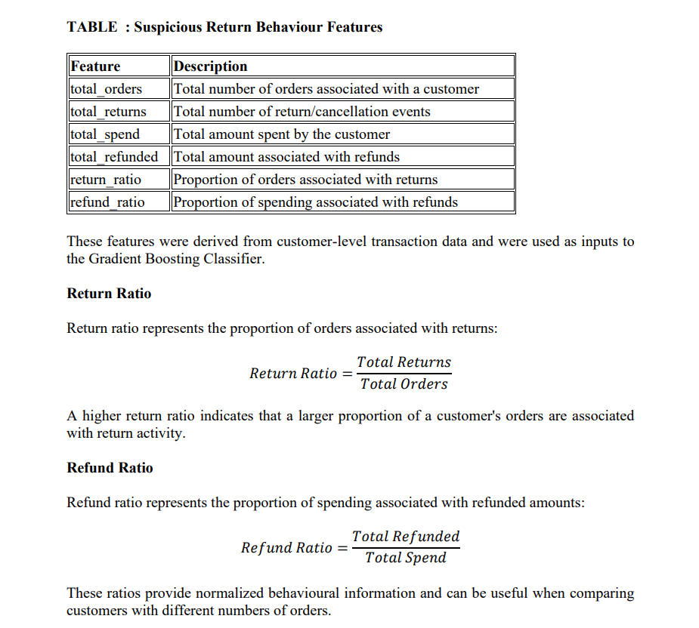
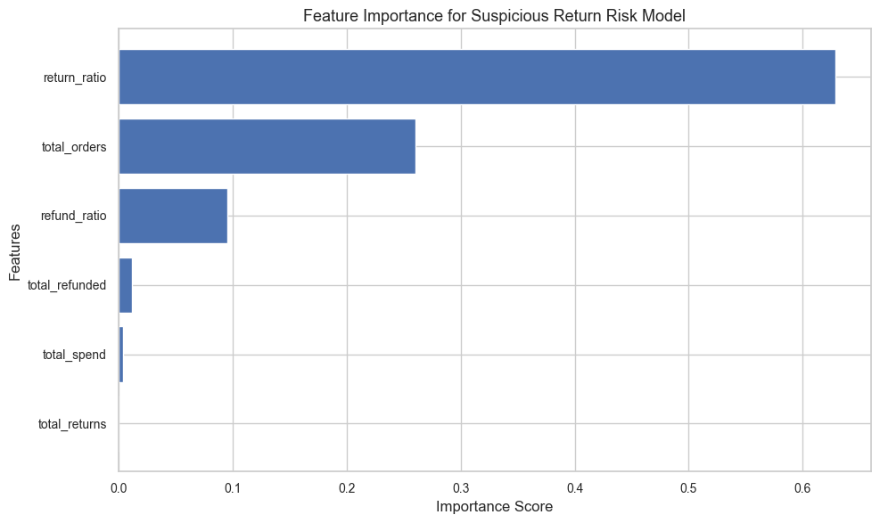
Gradient Boosting Classifier

Slide 8
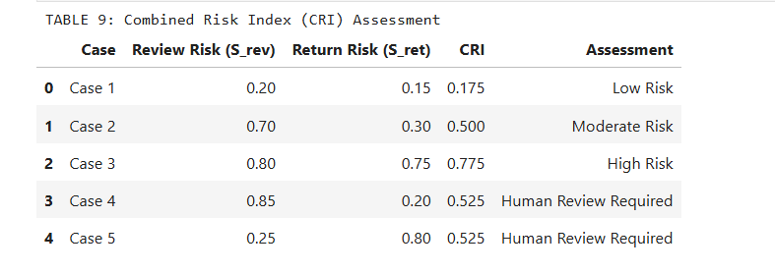
Combined Risk Index (CRI) Assessment
CRI Calculation: Combines review risk (Srev)and return risk (Sret) using a 50:50 weighted average.
Low Risk: Case 1 — CRI 17.5%.
Moderate Risk: Case 2 — CRI 50.0%.
High Risk: Case 3 — CRI 77.5%.
Human Review Required: Cases 4 and 5 — CRI 52.5%, where review and return risk signals differ significantly.
Decision Support: Flags suspicious cases for manual investigation instead of automatically confirming fraud.
Key takeaway: CRI combines two risk signals, while conflicting signals can trigger human review even when the overall score is moderate.

Slide 9
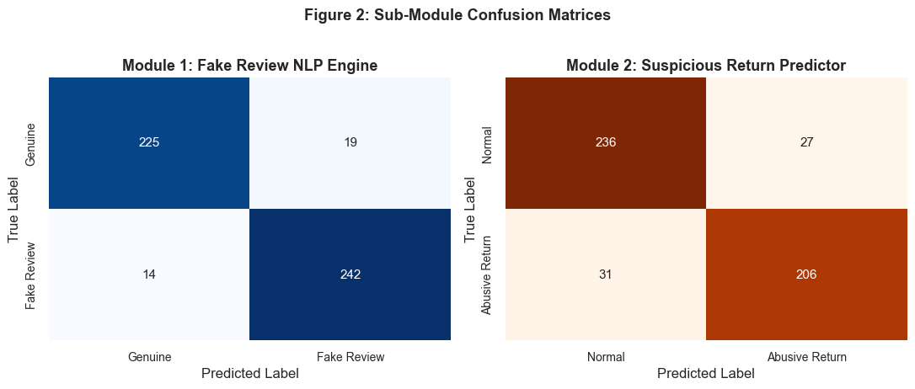
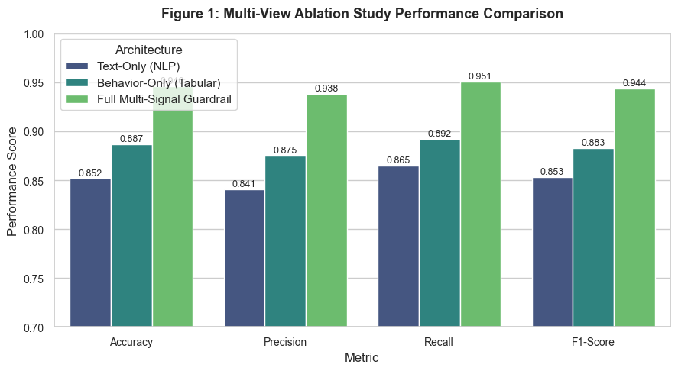
Model Performance, Explainability & Risk Analysis
Multi-View Performance: The full multi-signal Guardrail reports Accuracy 95.0%, Precision 93.8%, Recall 95.1%, and F1-score 94.4% in Figure 1.
Confusion Matrix: Figure 2 compares actual and predicted labels for fake reviews and suspicious returns, showing both correct classifications and errors.

Slide 10
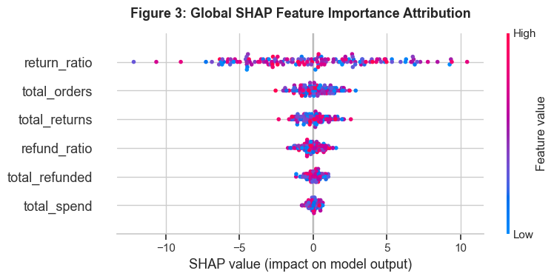
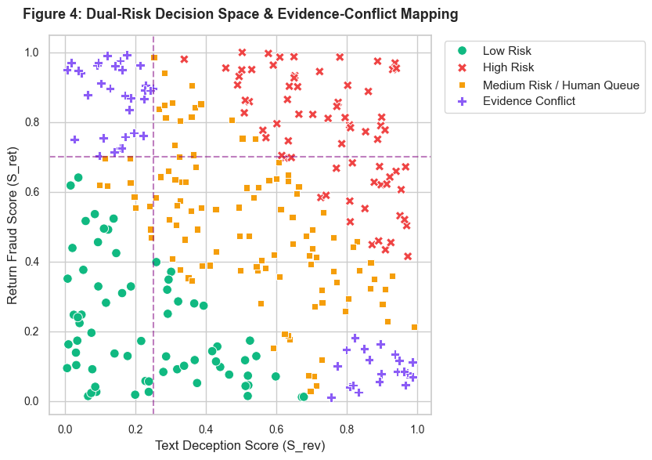
SHAP Explainability: Figure 3 highlights return_ratio as the most influential feature, followed by total_orders, total_returns, and refund_ratio.
Dual-Risk Decision Space: Figure 4 maps review deception scores against return fraud scores to distinguish low risk, high risk, medium-risk/manual-review cases, and evidence conflicts

Slide 11
Conclusion
Developed E-Commerce Guardrail, a multi-signal framework for assessing fake-review risk and suspicious return behaviour.
Combined NLP-based review analysis with machine-learning-based return-risk assessment.
Introduced the Combined Risk Index (CRI) to support risk prioritisation.
Used SHAP-based feature attribution and risk visualisations to improve interpretability.
Supported human review for suspicious cases and conflicting evidence.
Streamlit Dashboard — E-Commerce Guardrail :- 1.https://guradxai.streamlit.app
2. https://guradrail.streamlit.app (By Ankit Agrawal).
Thank You!
Questions & Answers

